Slide 1
Web Optimization
git@github.com:GTC-JS/ExtraPresentations.git

Slide 2
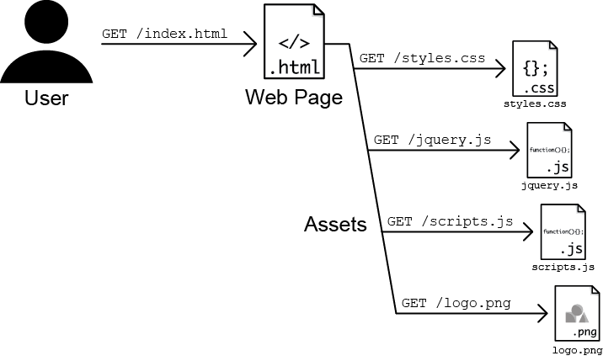
Asset Requests by Browser from Server
Notes:
As the web browser downloads the HTML, it discovers a <link> tag to a style sheet, a couple of <script> tags linking to some JavaScript files, and an <img> tag referring to an image.
Can be 100s of assets.

